Slide 1




CAR PRICE PREDICTION
Phillip Sethole

Slide 2
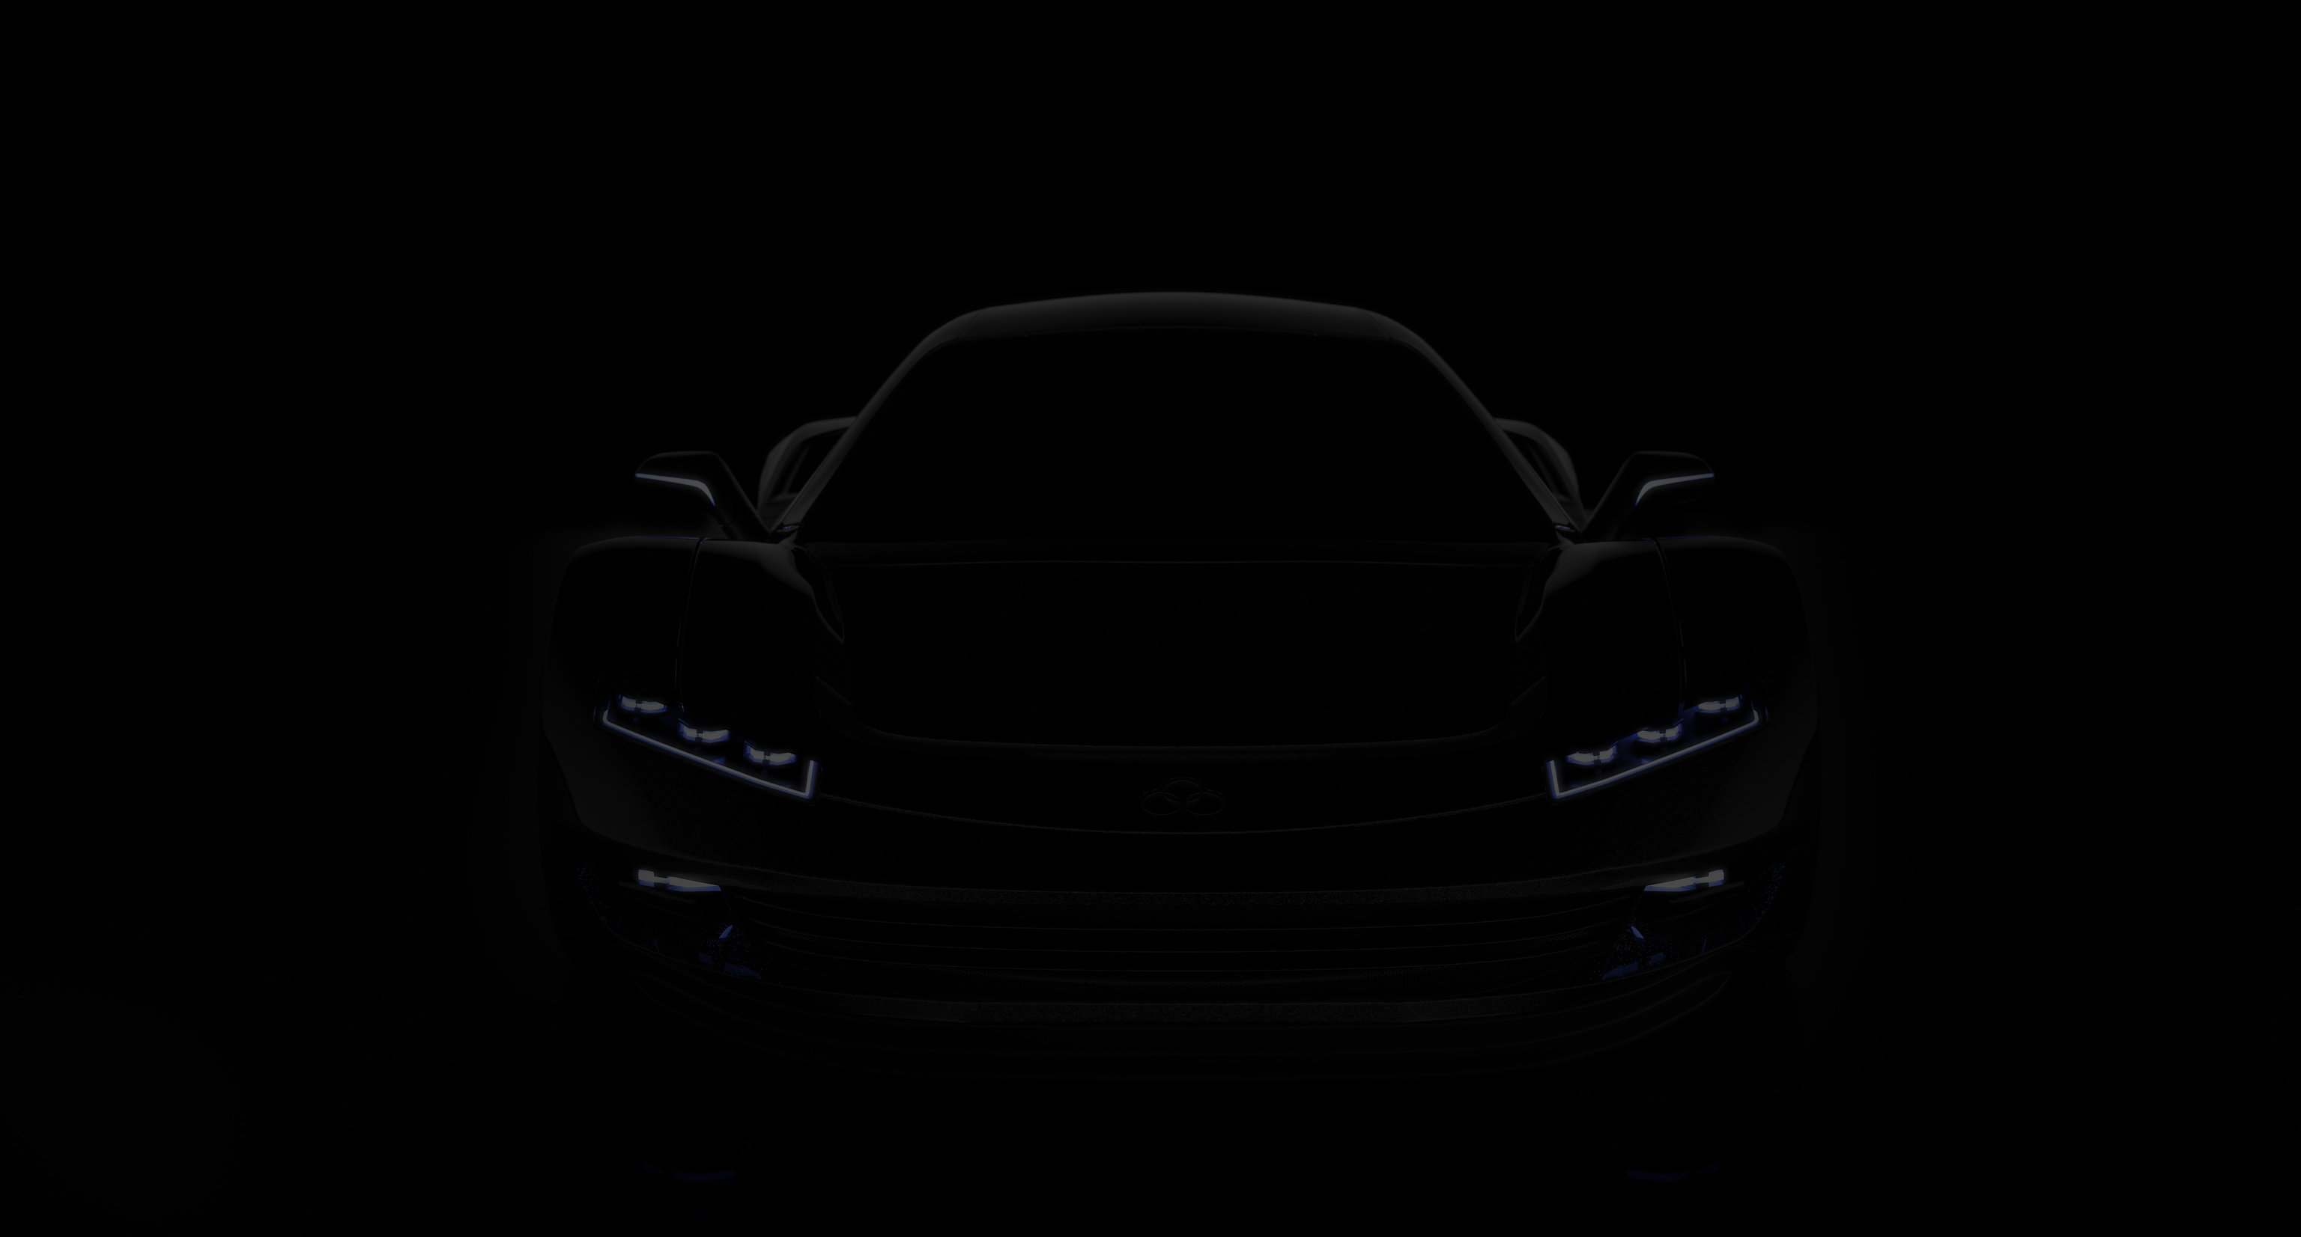

INTRODUCTION
What really determines the price of a car?

Slide 3

PROBLEM STATEMENT
Traditional methods of determining car prices often rely on manual appraisals, which can be subjective and inconsistent.

Slide 4
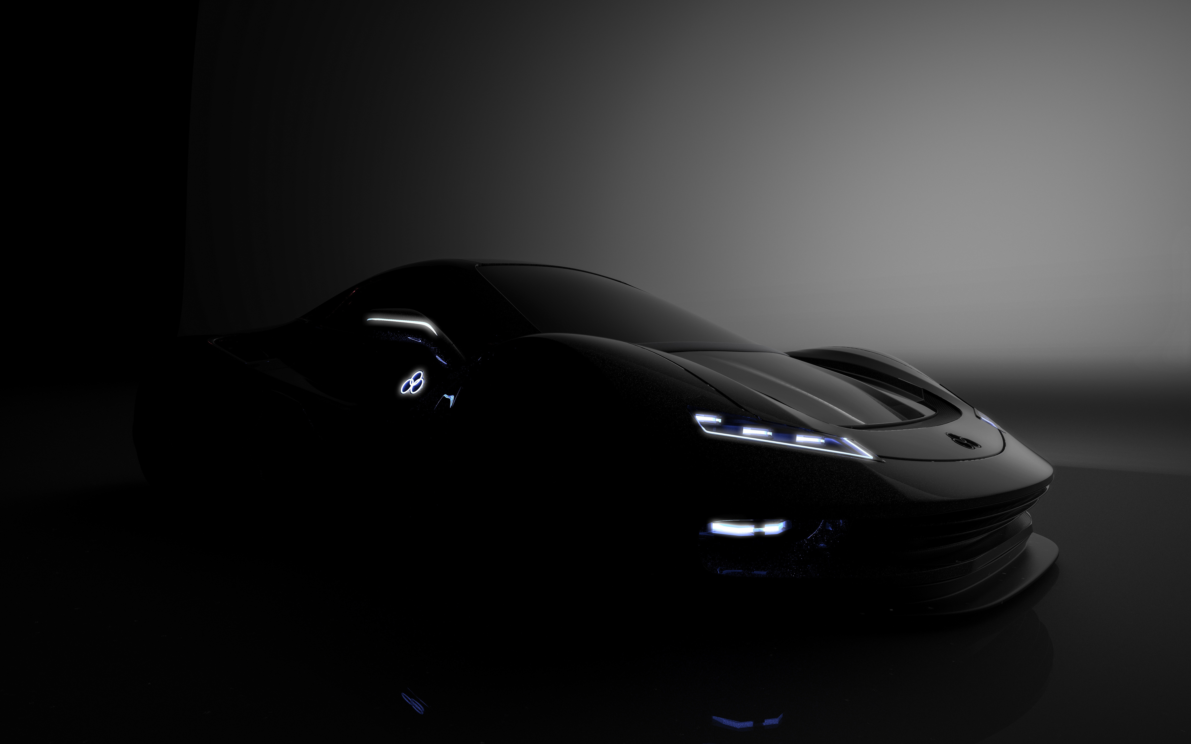
PROJECT GOALS
Develop a Machine Learning Model
Feature Analysis
Provide Insights

Slide 5






DATA CLEANING & PREPROCESSING

Slide 6
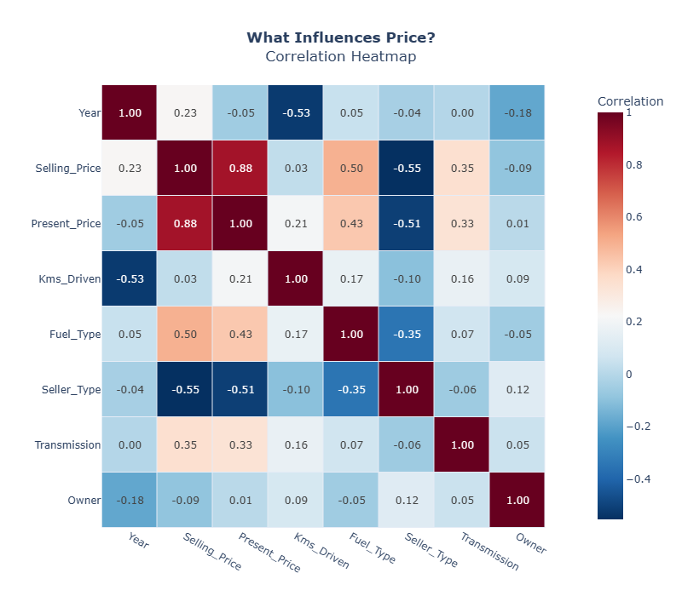
EXPLORATORY DATA ANALYSIS
📈 Present Price is the strongest predictor
⛽ Diesel cars tend to be priced higher
🧓 Older cars = lower prices
🤝 Individual sellers usually price lower than dealers

Slide 7

MODEL DEVELOPMENT
Model | R² (Test) | RMSE | MAE
Linear | 0.79 | 2.54 | 1.47
Ridge | 0.79 | 2.55 | 1.47
Lasso | 0.78 | 2.61 | 1.46
KNN | 0.81 | 2.45 | 1.36

Slide 8
FINAL MODEL & PERFORMANCE
Chosen model: KNN Regressor (k=5)
R²: 0.81, MAE: 1.36, RMSE: 2.45
Strong generalization across datasets
Best cross-validated performance

Slide 9

CONCLUSION & RECOMMENDATIONS
Present Price is the most important feature
Diesel > Petrol in resale value
Auto transmission cars tend to be more expensive
Mileage & owner count had limited impact

Slide 10

THANK YOU
EMAIL
philipsethole346@gmail.com

